Slide 1
DiceRolling
By: Narsi Gurjar
BCA VI-Sem

Slide 2

DiceRollingGame

Slide 3
What is DiceRolling?
DiceRolling is game website.
We play rolls dice game.
Two player play this game.
Your choice for Winnig-Score.

Slide 4
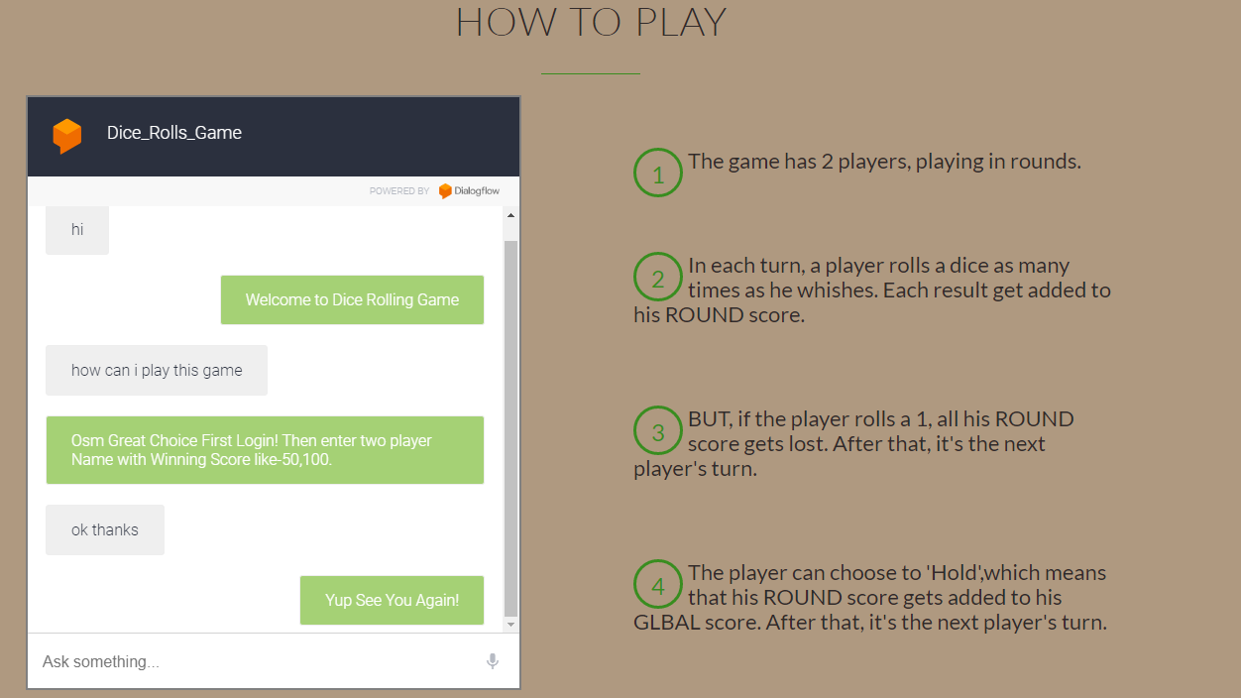

Slide 5
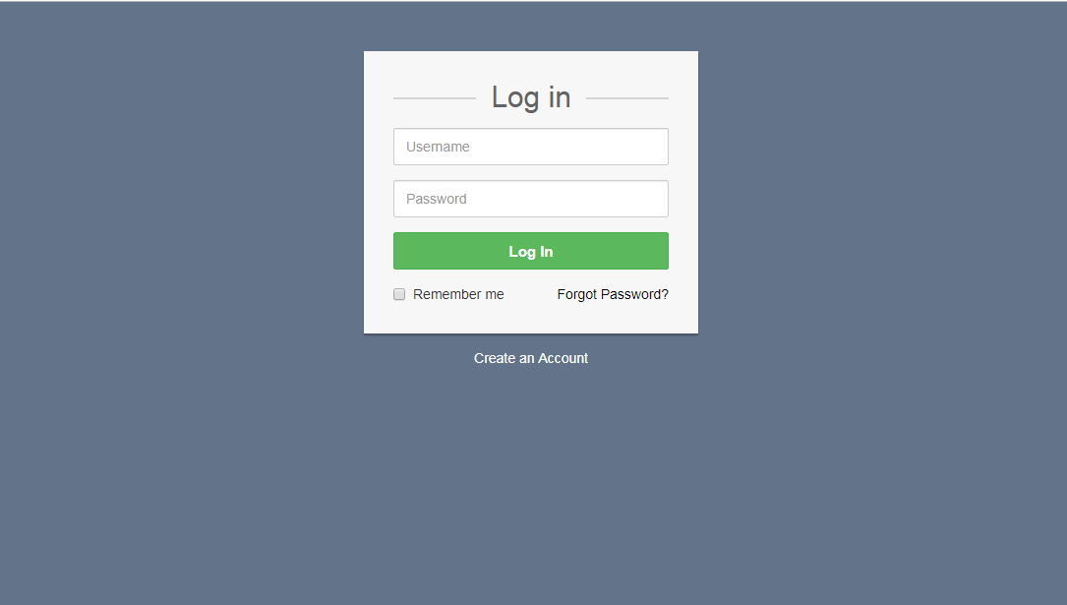
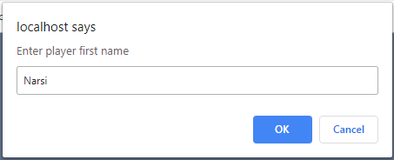
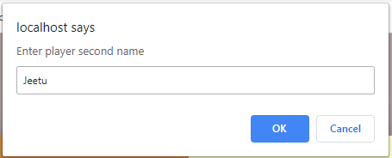
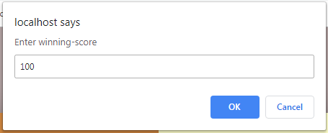
Play Game

Slide 6
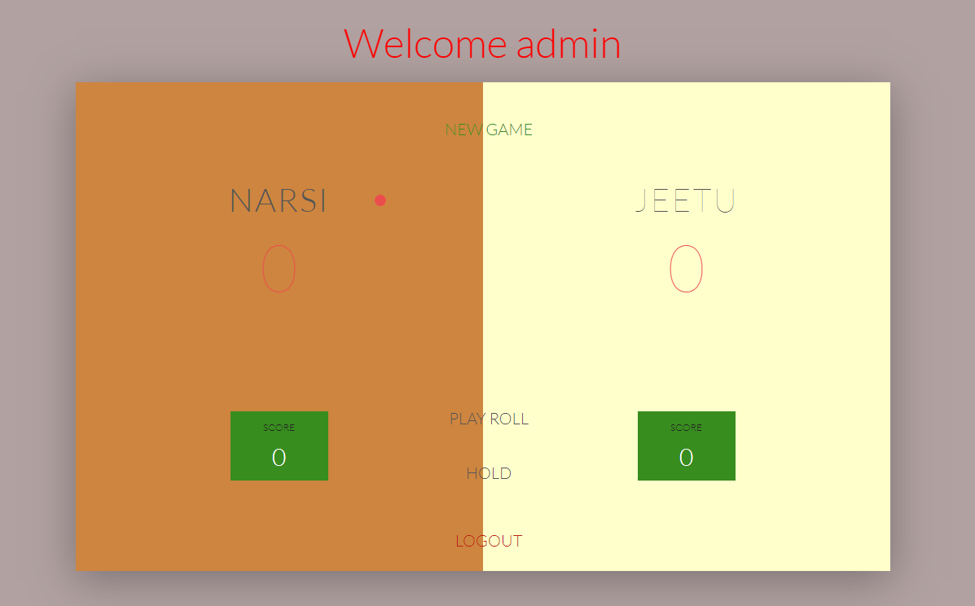

Slide 7
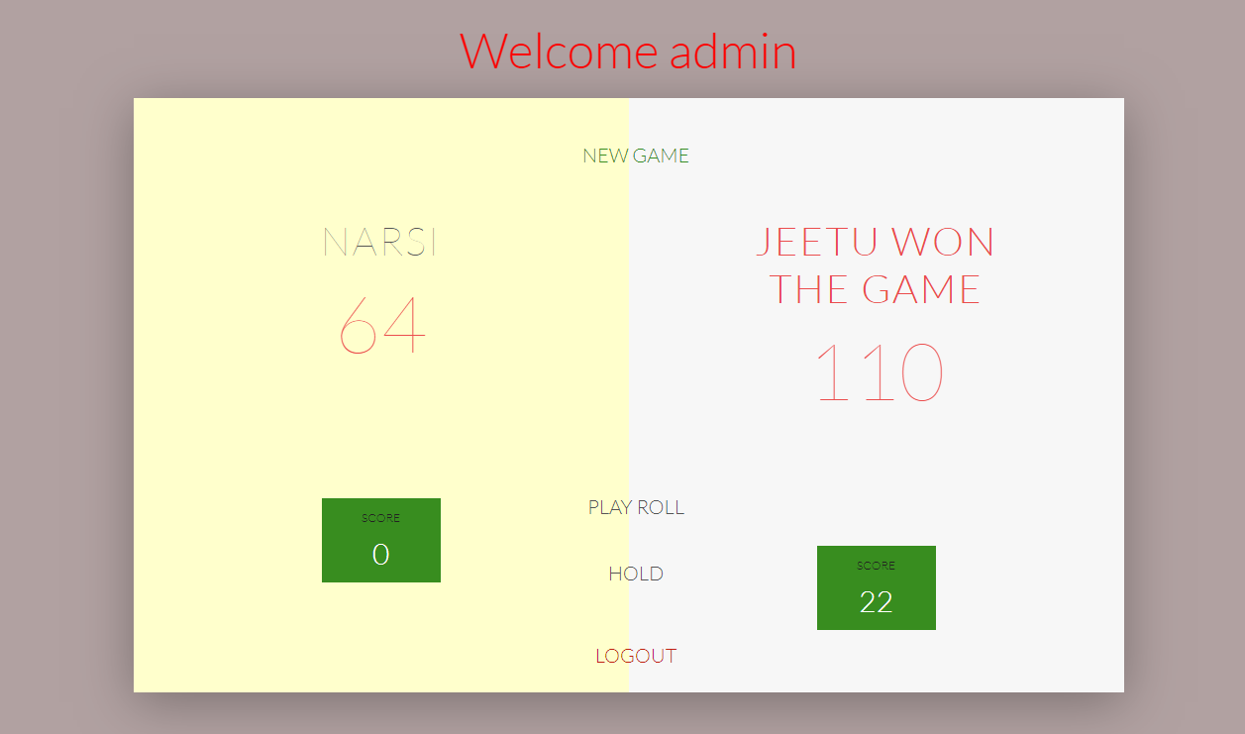

Slide 8
Thank You

